Slide 1
Configuring an Express application

Slide 2
Configuring an Express application
Express comes with a pretty simple configuration system, which enables you to add certain functionality to your Express application.
Although there are predefined configuration options that you can change to manipulate the way it works, you can also add your own key/value configuration options for any other usage.
Another robust feature of Express is the ability to configure your application based on the environment it's running on.
For instance, you may want to use the Express logger in your development environment and not in production, while compressing your responses body might seem like a good idea when running in a production environment.

Slide 3
Configuring an Express application (continued)
To achieve this, you will need to use the process.env property.
The process.env is a global variable that allows you to access predefined environment variables, and the most common one is the NODE_ENV environment variable.
The NODE_ENV environment variable is often used for environment-specific configurations.
To understand this better, let's go back to the previous example and add some external middleware.

Slide 4
Configuring an Express application (continued)
To use these middleware, you will first need to download and install them as your project dependencies.
To do so, edit your package.json file to look like the following code snippet:
{
"name": "MEAN",
"version": "0.0.3",
"dependencies": {
"express": "~4.8.8",
"morgan": "~1.3.0",
"compression": "~1.0.11",
"body-parser": "~1.8.0",
"method-override": "~2.2.0"
}
}

Slide 5
Configuring an Express application (continued)
As we previously stated:
the morgan module provides a simple logger middleware
the compression module will provide response compression
the body-parser module provides several middleware to handle request data
the method-override module provides DELETE and PUT HTTP verbs legacy support.

Slide 6
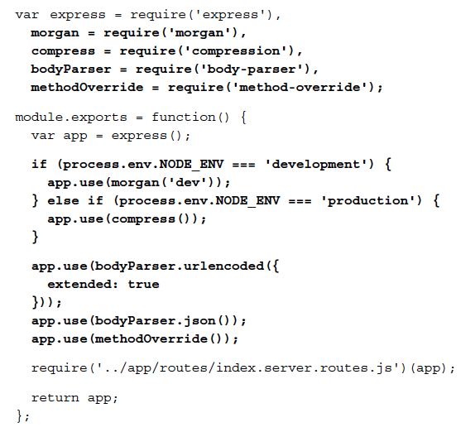
Configuring an Express application (continued)
To use these modules, you will need to modify your config/express.js file to look like the following code snippet:

Slide 7
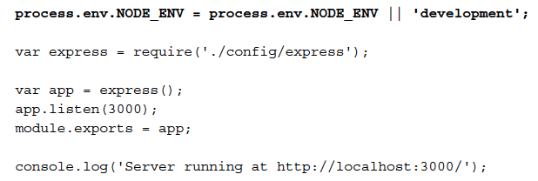
Configuring an Express application (continued)
To finalize your configuration, you'll need to change your server.js file to look like the following code snippet:

